Slide 1
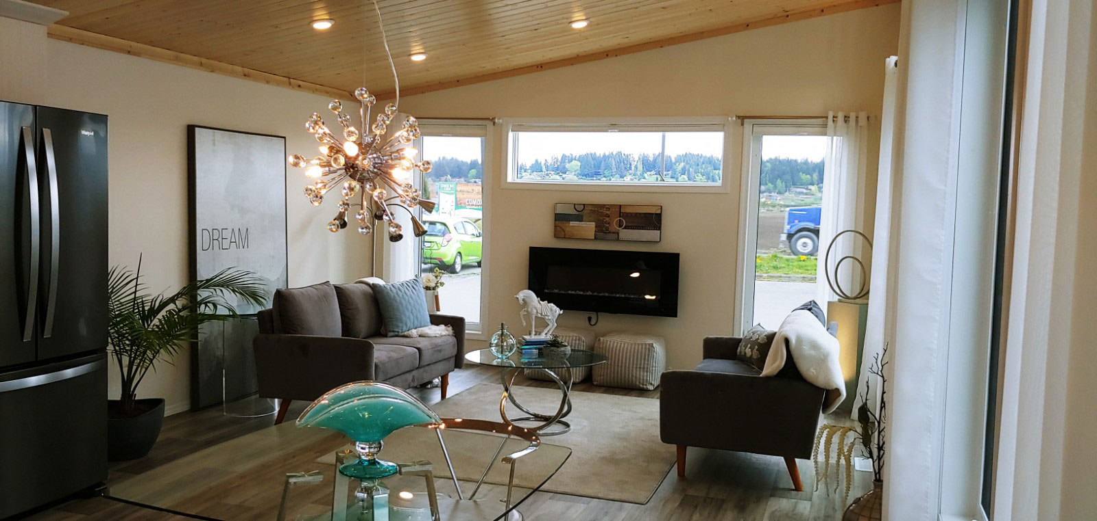
Brochure 2020

Slide 2
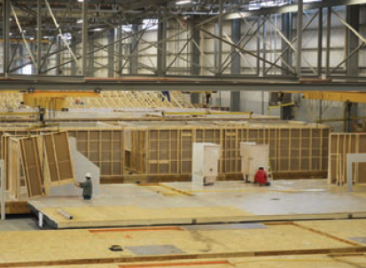
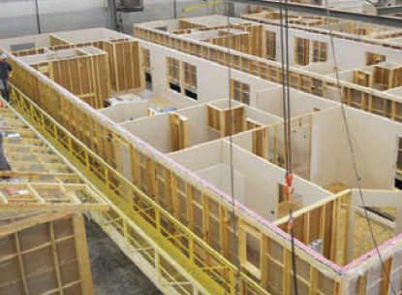
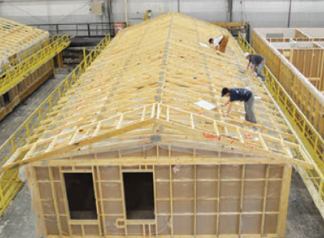
Exclusive Island Dealer for
The making of your dream home is much more than just choosing a floor plan, home style, upgrades and colours. It is the most important investment into life’s daily pleasures, family togetherness, shelter and security. Iconic Island Dwellings is equipped to help you craft your future home to meet these important needs without annoying sales pressure, all while minimizing the stresses of the new home creation process. Our vast choices of plans, styles and options make crafting your new home a satisfying reality. An industry leading 20 year manufacturer's warranty and attention to every detail in construction, transport and final finishing, complete your journey.
Why Factory Built?
The number of differences between traditional site-built homes and factory-built homes have shrunk in recent years, with factory-built housing quickly meeting and exceeding the standards long viewed to be the prerogative of site builders. While factory-built structures are constructed to the same national and provincial standards as site-built homes, the exceptional quality of factory built homes becomes strikingly apparent once you examine the home-building process. With materials and construction performed within climate-controlled facilities, by dedicated trained professionals, and under the inspection of third party agencies, our homes are not plagued by the challenges of rotating seasonal staff or inclement weather. Likewise, daily ongoing inspection and training ensures that challenges are met early and often, reducing the possibility of undiagnosed concerns.
By using automation within the factory floor, from the cuts of lumber to the raising of walls, we can ensure stability and consistency across all jobs performed. This consistency and environmental focus adds to the exceptional energy efficiency of the final home, ensuring the home saves you money. Finally, by using our one-of-a-kind Ridge Wall System, we build strength into the finished product. Through lateral bracing, double continuous headers, continuous vapour barriers, and compressed floor-to-wall-to-ceiling fastenings, we minimize deflection and allow for the future craning or rolling into place upon arrival. It is this strength that allows for our industry-leading 20-year structural warranty.

Slide 3
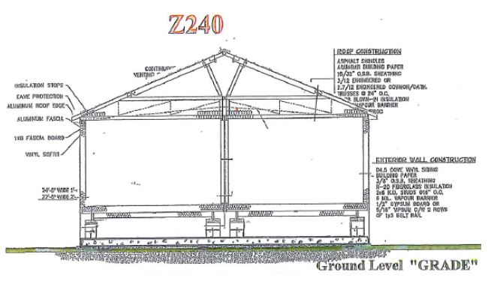
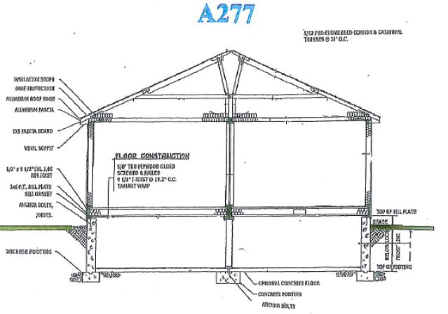
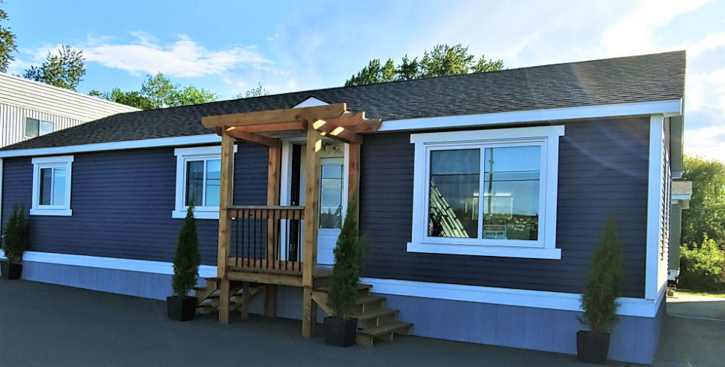
Construction
CSA Standard Z240 – Manufactured Homes
Laminate Countertop
Manufactured Homes, or those built to the CSA Standard Z240, are homes built in both sectional (meaning 2 halves) and single sectional types. Sectional homes are constructed on large metal frames and delivered to the site where they are blocked and leveled on concrete blocks from the frame to support the home. They generally sit approximately three feet above ground and would be skirted to the ground with wood or vinyl.
Pale Faces-Carpet
G969M Houston-Lino
CSA Standard A277 – Modular Homes
Modular Homes, or those built to the CSA Standard A277, which is the same standard as a site built home. Modular homes are built on wood frames, are transported on a flat deck (float), and must be craned or rolled onto a prepared crawlspace or basement, depending on the style ordered. These generally sit ground level and would not require skirting. Modular Homes can be offered in both single sections and double sections.

Slide 4
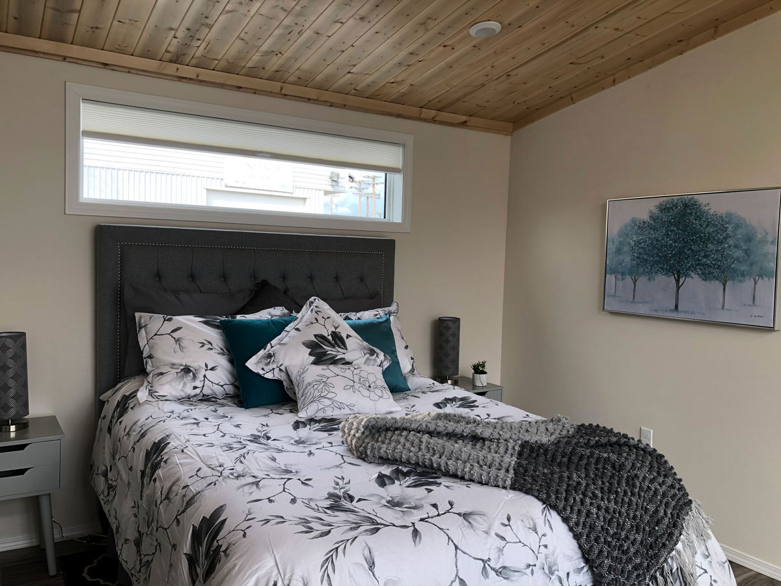
Turn Key Service
At Iconic Island Dwellings, we strive to make your experience stress-free. We offer a “one-stop-shop” service, that will take you from permitting to moving in and everything in between. We have an experienced team ready to handle all administrative duties such as applying and acquiring permits, and in-house designers to assist you with the many options available for your new home. We will do site preparation of your property including foundation, excavation, fill and storm drains. We have certified electricians, plumbers, carpenters and water specialists that can bring the necessary services such as hydro hookups, exterior lights, additional conduits, connections from incoming water and sewer, gutters and downspouts, garages, decks, steps and skirting if necessary. As a buyer, simply enjoy the thrill of your new home…let us do the rest!
Our Process
We want your next building project to be simple. So we’ve developed a 3 step process to home-building that demonstrates the many ways in which our strengths go far beyond the usual. We deliver on a quality product and bring value to the table every step of the way giving you that extra level of service you deserve.
Step 1: Initiate
Browse our website for your home ideas
Select your favorite home floor plans
Contact our Sales Center
Make an appointment with our Sales team
Confirm your new home floor plan
Select your interior and exterior options
Finalize your home order quote
Obtain your home bank approval
Step 2: Implement
Finalize & sign your home design
x and enjoy the home process
Construction of your home begins
Site prep, foundation, septic begins
Delivery of your home
Interior & exterior finish work
Connections to services
Quality check and cleaning
Step 3: Inhabit
Closing Day of your home
Walk-through of your home
Review of systems & maintenance
Final payment and your keys
You're a new home owner
Move in and enjoy
Service & 20 year warranty begins
Service walk-through

Slide 5
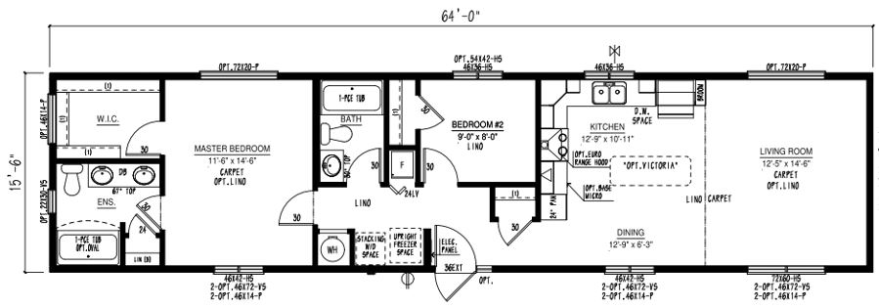
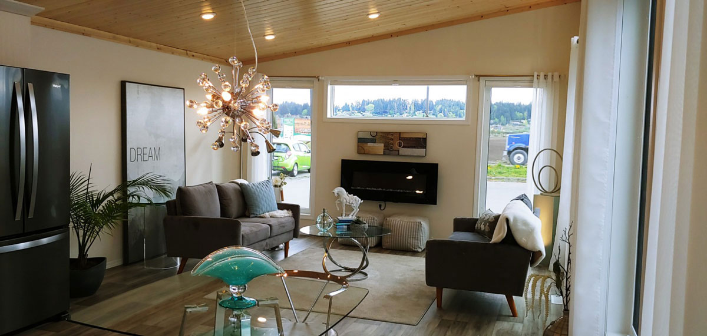
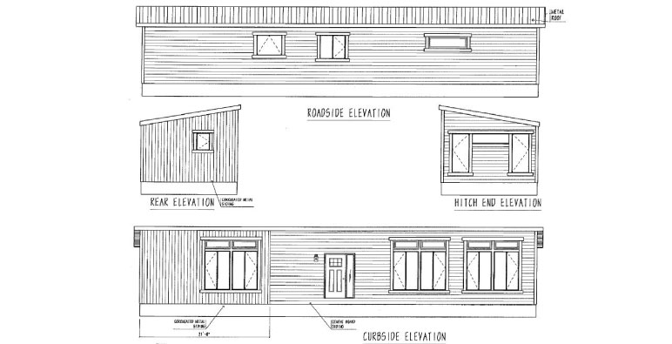
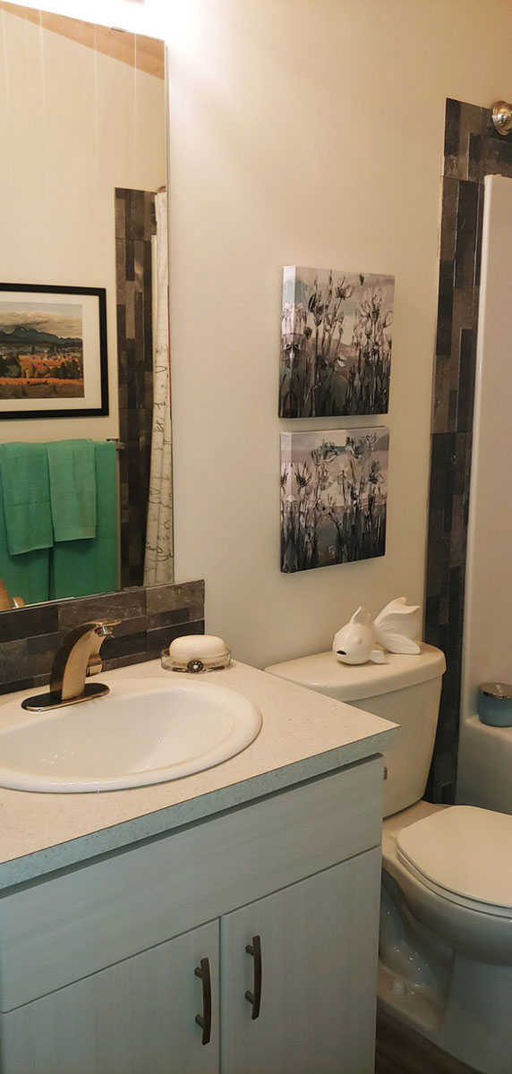
Our Designs & Floor Plans
Our Design & Sales Team will work with you to create your Dream Home! We offer over 100 unique floor plans to suit your style and needs. These floor plans range from single wide, double wide, and two-story options, and range in number of bedrooms and bathrooms featured. Our homes can be customized to suit your preferences in flooring, paint colour, counter tops and cabinets, exterior siding colour and much more. We can also alter any floor plan to move walls, add windows and doors or delete bathrooms – the possibilities are endless!
Laminate Countertop
Looks Lakatre
Pale Faces-Carpet
Show Home Skyview

Slide 6
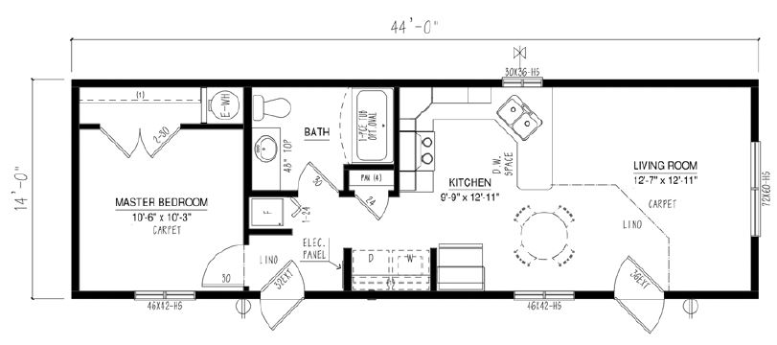
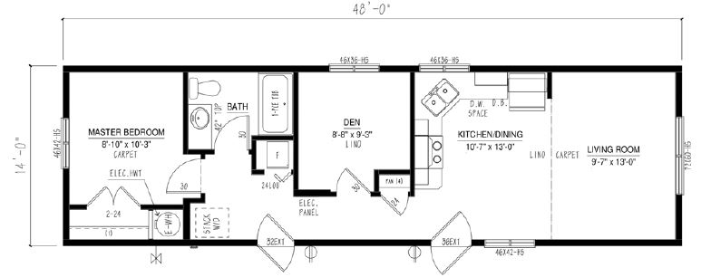
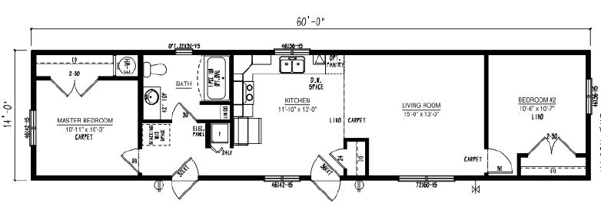
Single Floor Plan Options
BC1444-102-C-1
BC1448-100-C-1
BC1460-201-C-1
2020
Iconic Island Dwellings reserves the right to change standards specifications without prior notice. See sales associate for details

Slide 7
Single Floor Plan Options
BC1466-222-C-1
BC1466-227-C-1
BC1466-229-C-1
2020
Iconic Island Dwellings reserves the right to change standards specifications without prior notice. See sales associate for details

Slide 8
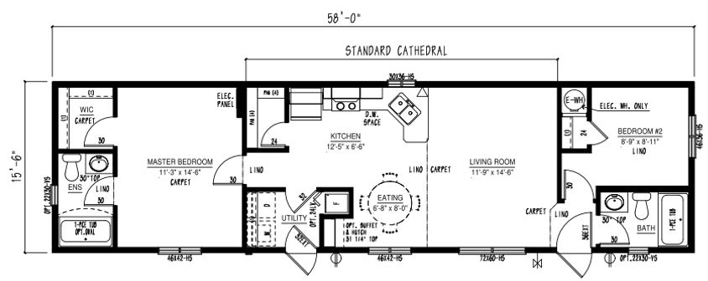
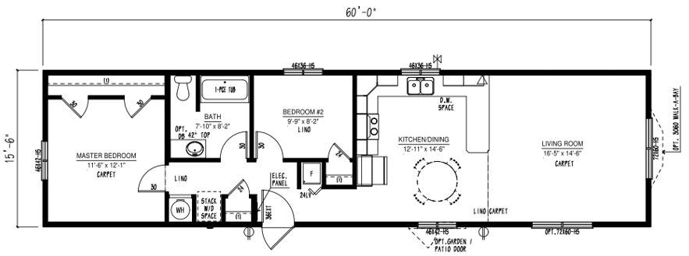
Single Floor Plan Options
BC1466-230-C-1
BC1658-101-C-1
BC1660-313-C-1
2020
Iconic Island Dwellings reserves the right to change standards specifications without prior notice. See sales associate for details

Slide 9
Single Floor Plan Options
BC1664-305-C-1
BC1664-306-C-1
BC1666-301-C-1
2020
Iconic Island Dwellings reserves the right to change standards specifications without prior notice. See sales associate for details

Slide 10
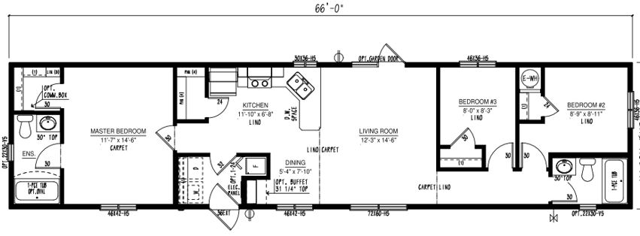
Single Floor Plan Options
BC1666-303-C-1
BC1666-304-C-1
BC1666-305-C-1
2020
Iconic Island Dwellings reserves the right to change standards specifications without prior notice. See sales associate for details

Slide 11
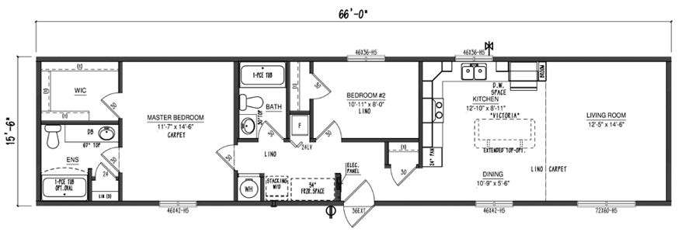
Single Floor Plan Options
BC1666-306-C-1
BC1670-100-C-1
2020
Iconic Island Dwellings reserves the right to change standards specifications without prior notice. See sales associate for details

Slide 12
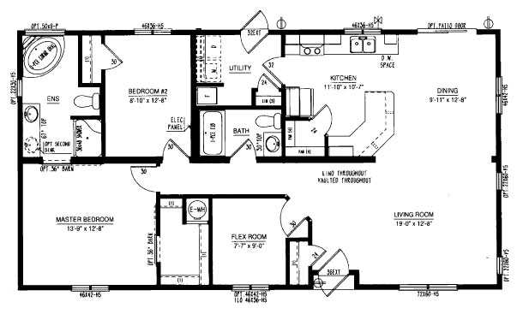
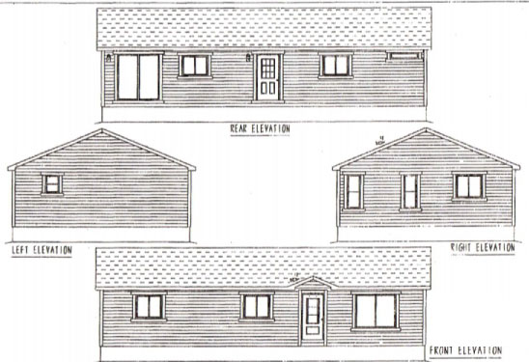
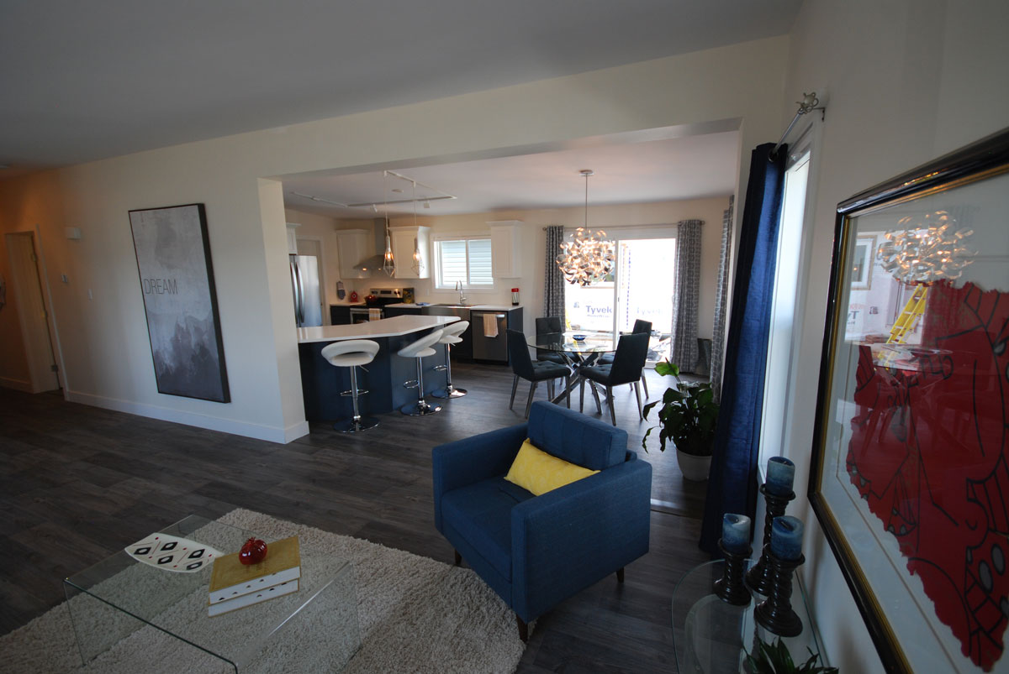
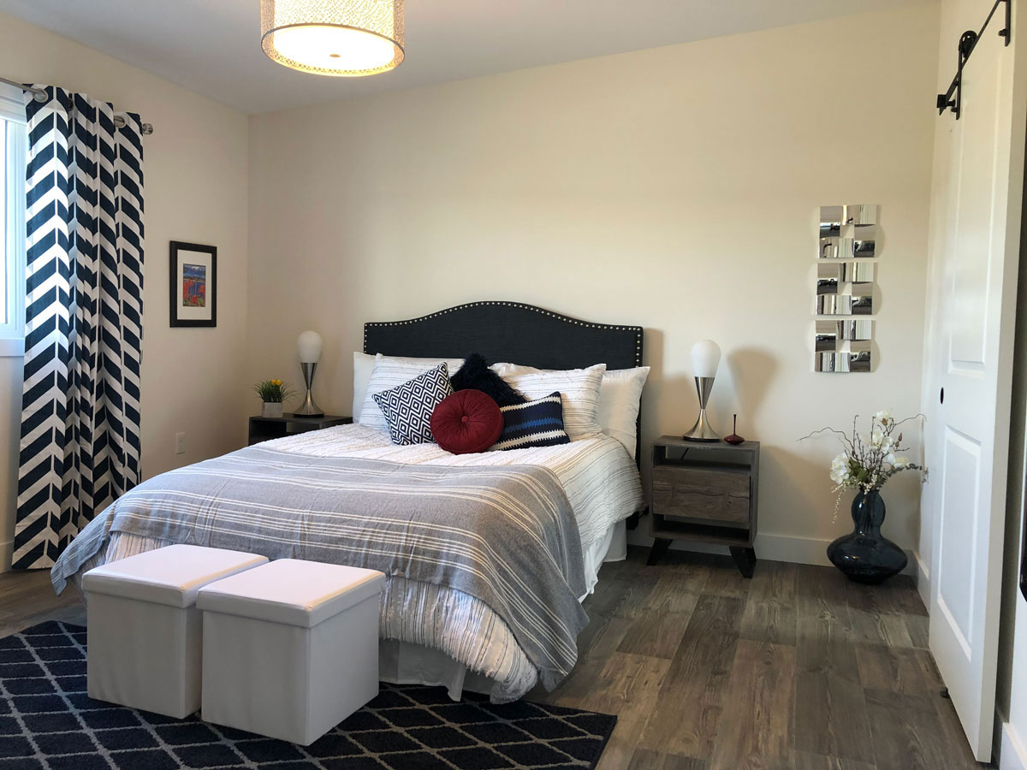
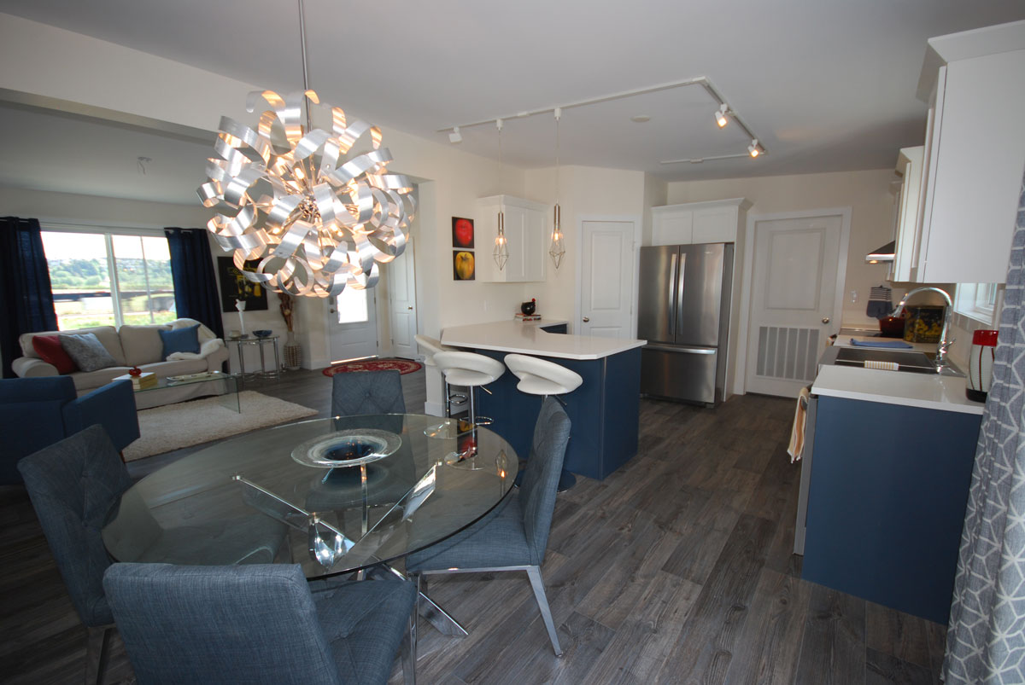
Multi Section Floor Plans
Show Home Silverwater

Slide 13
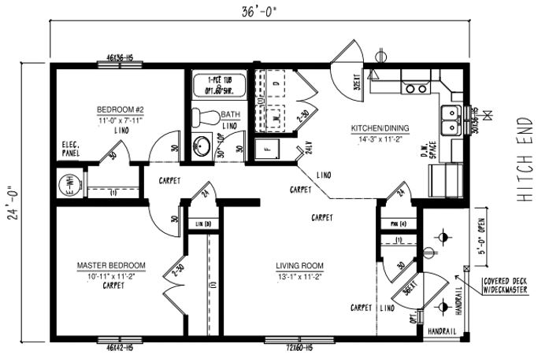
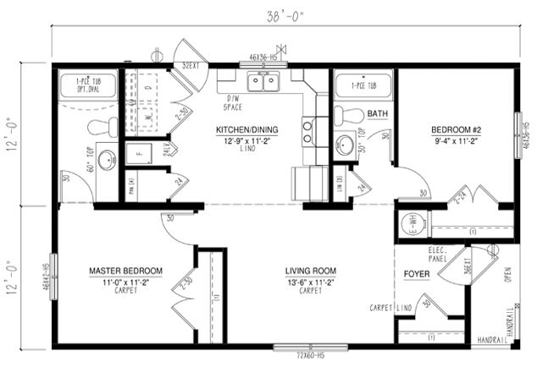
Multi Section Floor Plan Options
BC2436-100-C-1
BC2438-101-C-1
2020
Iconic Island Dwellings reserves the right to change standards specifications without prior notice. See sales associate for details

Slide 14
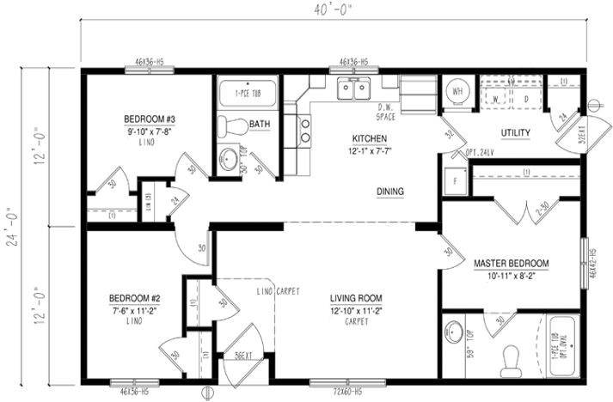
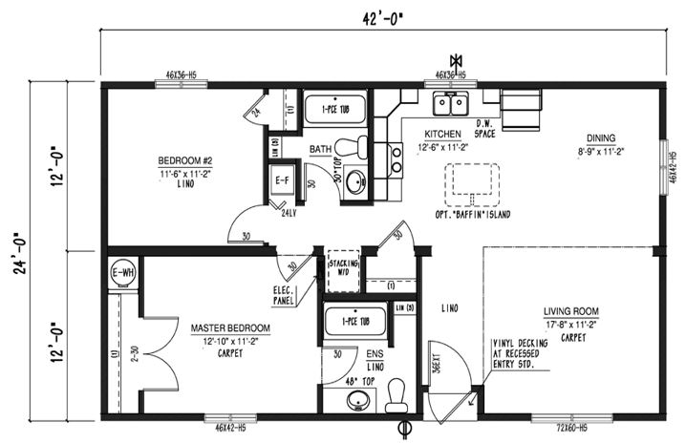
Multi Section Floor Plan Options
BC2440-102-C-1
BC2442-101-C-1
2020
Iconic Island Dwellings reserves the right to change standards specifications without prior notice. See sales associate for details

Slide 15
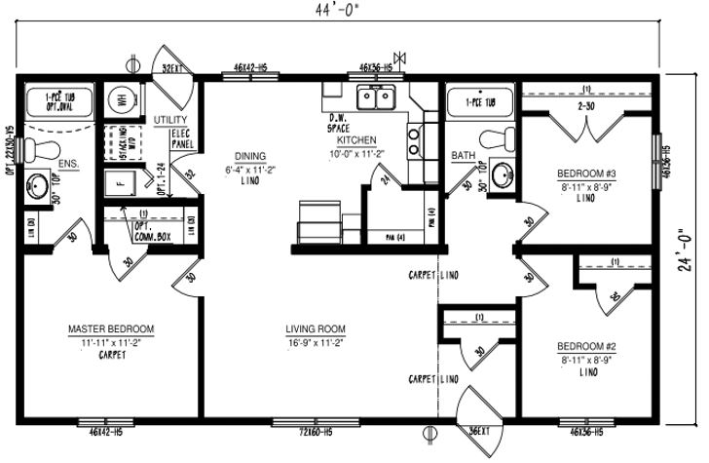
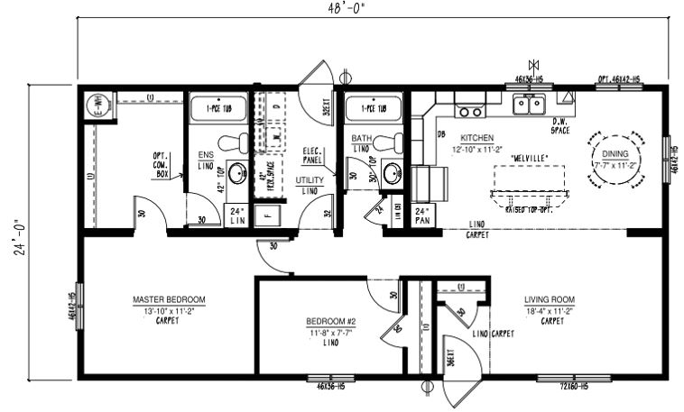
Multi Section Floor Plan Options
BC2444-102-C-1
BC2448-103-C-1
2020
Iconic Island Dwellings reserves the right to change standards specifications without prior notice. See sales associate for details

Slide 16
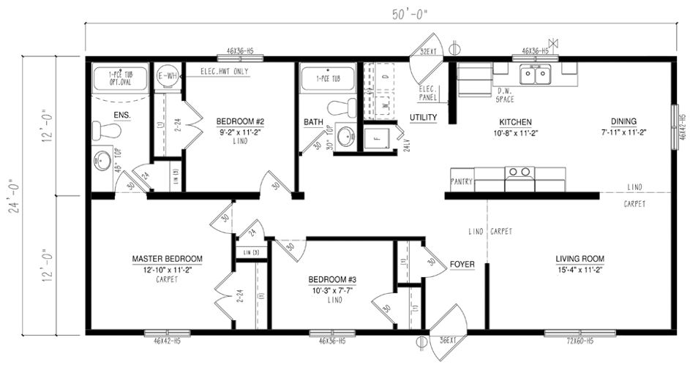
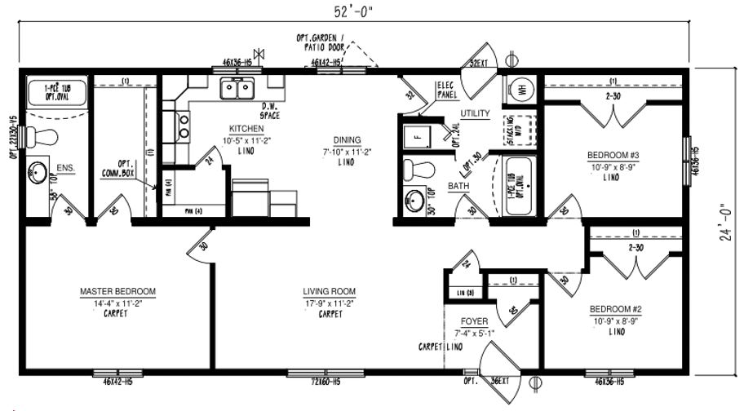
Multi Section Floor Plan Options
BC2450-109-C-1
BC2452-101-C-1
2020
Iconic Island Dwellings reserves the right to change standards specifications without prior notice. See sales associate for details

Slide 17
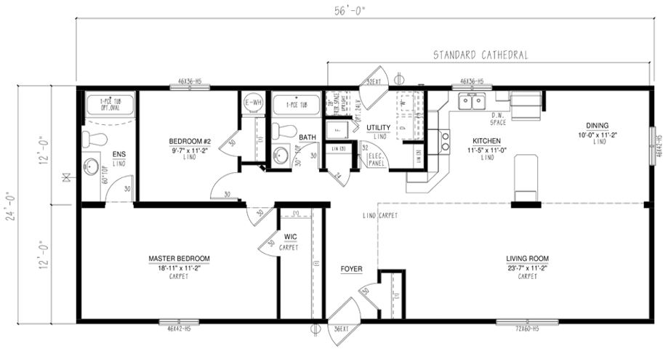
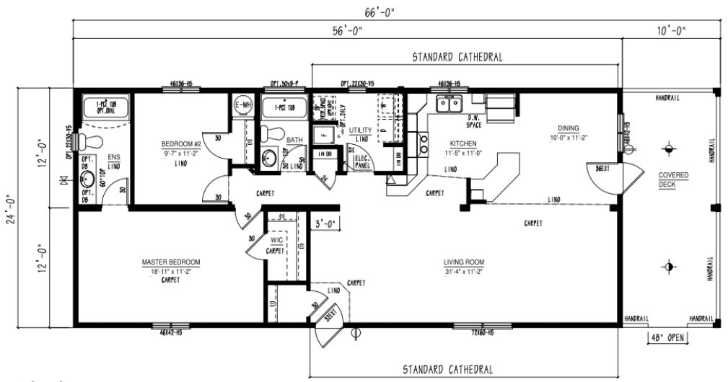
Multi Section Floor Plan Options
BC2456-101-C-1
BC2466-100-C-1
2020
Iconic Island Dwellings reserves the right to change standards specifications without prior notice. See sales associate for details

Slide 18
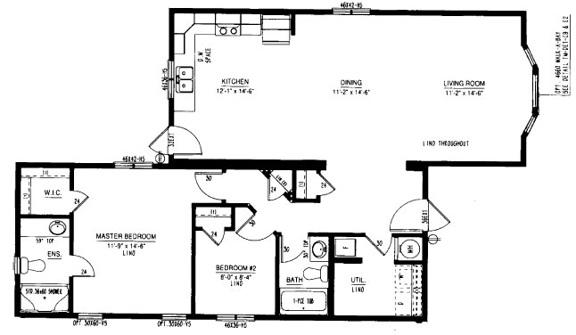
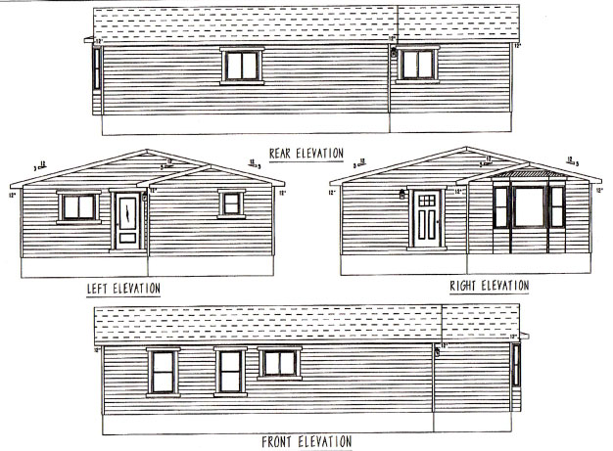
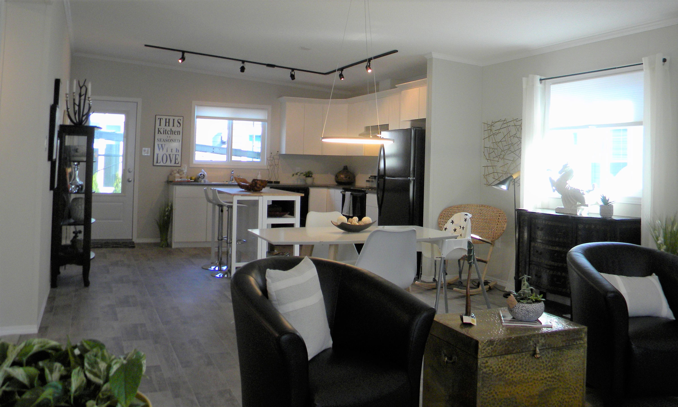
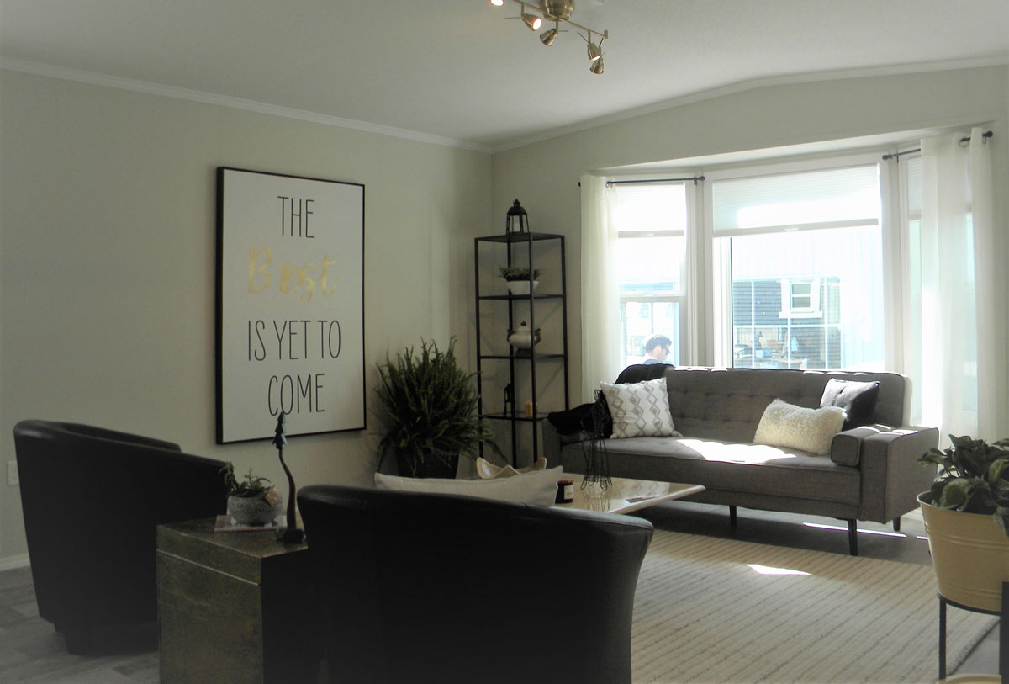
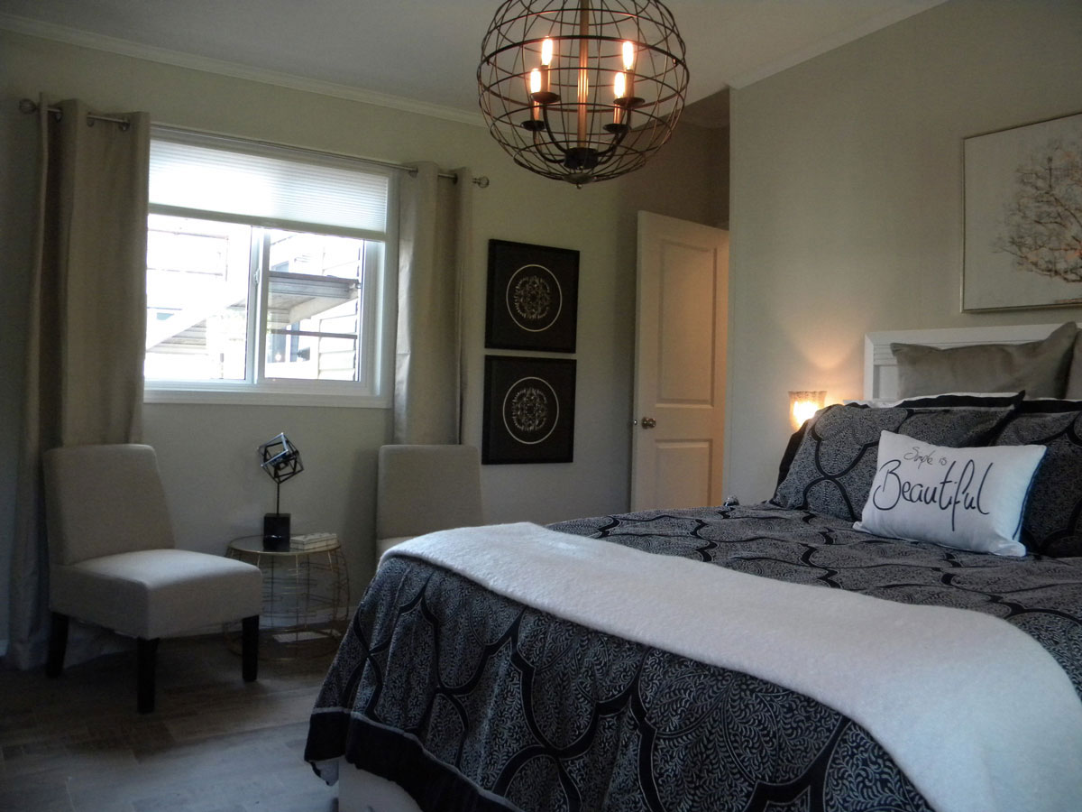
Multi Section Floor Plans
Show Home Aspen

Slide 19
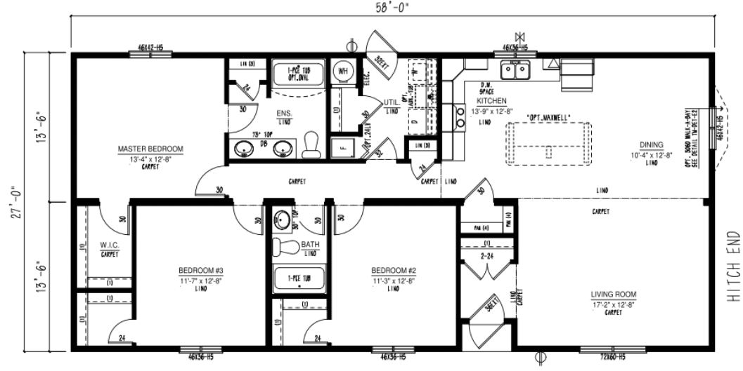
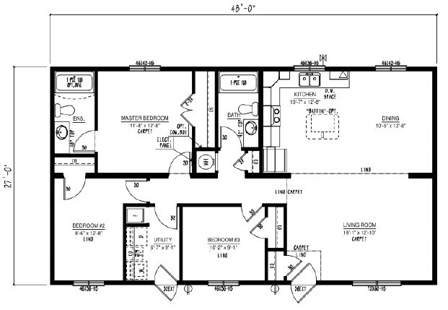
Multi Section Floor Plan Options
BC2744-102-C-1
BC2748-102-C-1
2020
Iconic Island Dwellings reserves the right to change standards specifications without prior notice. See sales associate for details

Slide 20
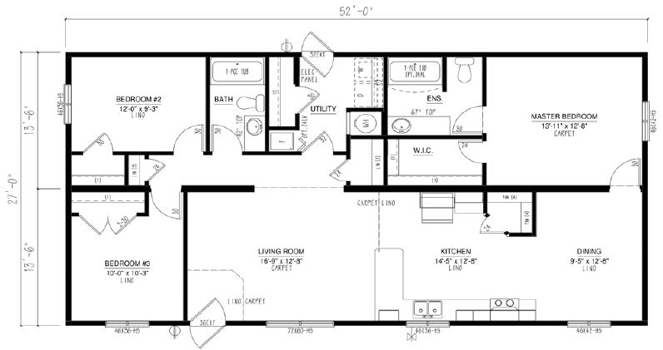
Multi Section Floor Plan Options
BC2752-102-C-1
BC2756-104-C-1
2020
Iconic Island Dwellings reserves the right to change standards specifications without prior notice. See sales associate for details

Slide 21
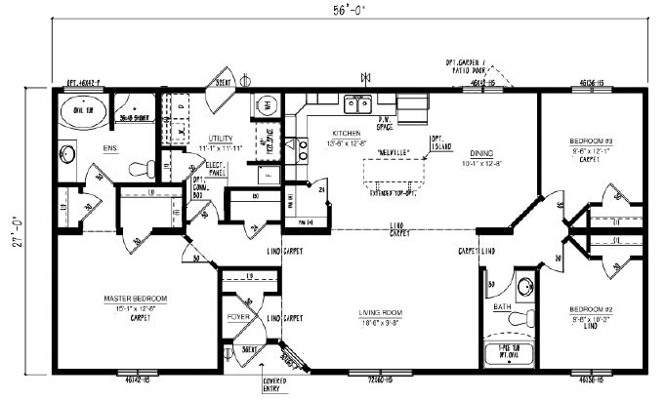
Multi Section Floor Plan Options
BC2756-107-C-1
BC2758-103-C-1
2020
Iconic Island Dwellings reserves the right to change standards specifications without prior notice. See sales associate for details

Slide 22
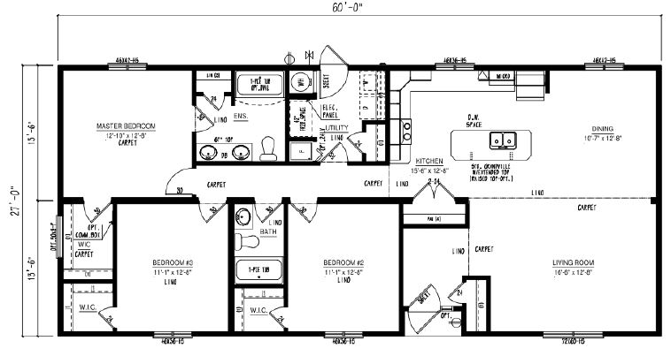
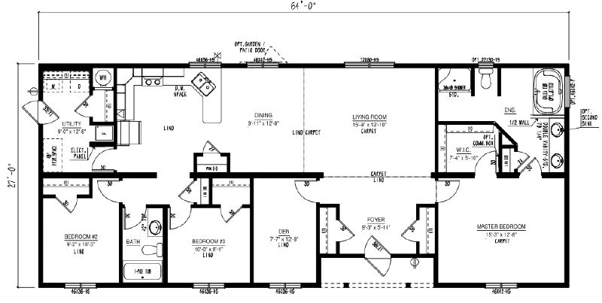
Multi Section Floor Plan Options
BC2760-100-C-1
BC2764-100-C-1
2020
Iconic Island Dwellings reserves the right to change standards specifications without prior notice. See sales associate for details

Slide 23
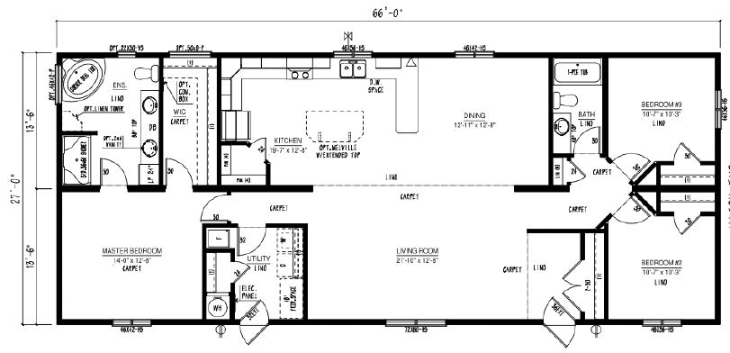
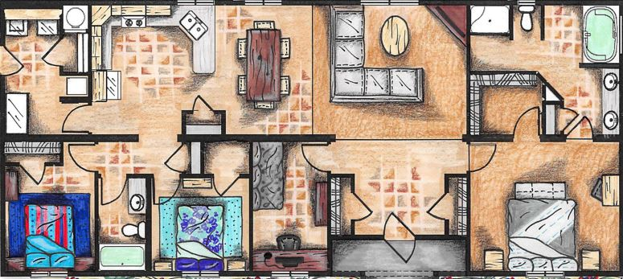
Multi Section Floor Plan Options
BC2766-101-C-1
2020
Iconic Island Dwellings reserves the right to change standards specifications without prior notice. See sales associate for details

Slide 24
Meet the Iconic Team
The making of your dream home is much more than just choosing a floor plan, home style, upgrades and colours. It is the most important investment into life’s daily pleasures, family togetherness, shelter and security. Iconic Island Dwellings is equipped to help you craft your future home to meet these important needs without annoying sales pressure, all while minimizing the stresses of the new home creation process. Our vast choices of plans, styles and options make crafting your new home a satisfying reality. An industry leading 20 year manufacturer’s warranty and attention to every detail in construction, transport and final finishing, complete your journey.
Chris Andersen
Cat KeyLock
Kip Keylock
General Manager
Sales & Marketing
Head Designer
Business Development
Manager
www.iconicislanddwellings.ca | Courtenay Vancouver Island | 250-871-7766

